Slide 1




Spring Data Advanced Querying
Query Methods, JPQL
Advanced Repositories
Spring configuration
Advanced
Querying
SoftUni Team
Technical Trainers
Software University
http://softuni.bg

Slide 2

Table of Contents
Query Methods
JPQL
Advanced Repositories
Spring configuration

Slide 3
Questions
sli.do #db-advanced

Slide 4

Query Methods

Slide 5
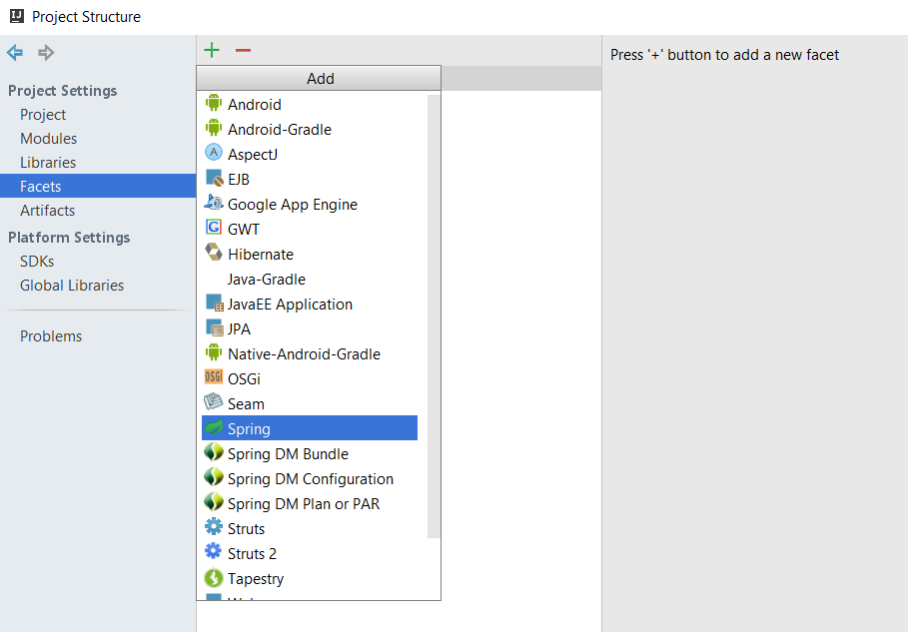
Spring Facet

Slide 6
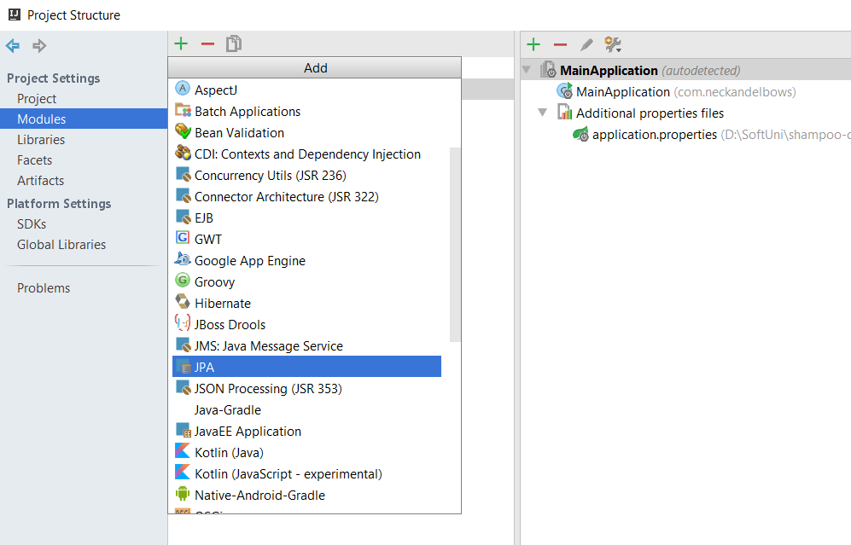
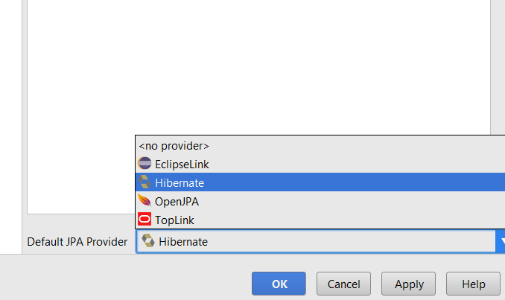
JPA Facet

Slide 7
Query methods
BasicShampooDao.java
@Repository
public interface BasicShampooDao extends JpaRepository<BasicShampoo, Long> {
List<BasicShampoo> findByBrand(String brand);
}
Query method
Paramater
SQL
SELECT *
FROM shampoos AS s
WHERE s.brand = ?
Paramater

Slide 8
Query Lookup
Query Prefix
Field
List<BasicShampoo> findByBrand(String brand);
Return Type
Query Prefix
Field
List<BasicShampoo> findByBrandAndSize (String brand, Size size);
Field
Predicate Keyword

Slide 9
Query methods
BasicShampooDao.java
@Repository
public interface BasicShampooDao extends JpaRepository<BasicShampoo, Long> {
List<BasicShampoo> findByBrandAndSize(String brand, Size size);
}
Query method
Paramater
Paramater
SQL
SELECT *
FROM shampoos AS s
WHERE s.brand = ?
AND s.size = ?

Slide 10

JPQL

Slide 11
JPQL Functionalities
JPQL
SELECT
UPDATE
DELETE

Slide 12
JPQL Select Syntax
Class
Field
"SELECT b FROM BasicIngredient AS b WHERE b.name IN :names"
Object
Alias
Paramater

Slide 13
JPQL Join Syntax
Object
Class
"SELECT s
FROM BasicShampoo AS s
INNER JOIN s.batch AS b
WHERE b.batchDate < :batchDate"
Join
Field
Paramater

Slide 14
JPQL Update Syntax
Update
Alias
"UPDATE BasicIngredient AS b
SET b.price = b.price*1.10
WHERE b.name IN :names"
Field
Paramater

Slide 15
JPQL Delete Syntax
Delete
Alias
"DELETE FROM BasicIngredient AS b
WHERE b.name = :name"
Field
Paramater

Slide 16
Query
BasicShampooDao.java
@Repository
public interface BasicIngredientDao extends JpaRepository<BasicIngredient, Long>{
@Query(value = "SELECT b FROM BasicIngredient AS b WHERE b.name IN :names")
List<BasicIngredient> findByNames(@Param(value = "names") List<String> names);
}
Query
Paramater
Paramater
SQL
SELECT *
FROM ingredients AS i
WHERE i.name IN (?)
Paramater

Slide 17
Named Query
ProductionBatch.java
Named Query
@Entity
@Table(name = "batches")
@NamedQuery(name = "ProductionBatch.findByDate",
query = "SELECT b FROM ProductionBatch AS b WHERE b.batchDate = :date")
public class ProductionBatch implements Batch{
//…
}
Query
Paramater
ProductionBatchDao.java
@Repository public interface ProductionBatchDao extends JpaRepository<ProductionBatch, Long>{
List<ProductionBatch> findByDate(@Param(value = "date") Date date);
}
Query Name

Slide 18

Advanced Repositories

Slide 19
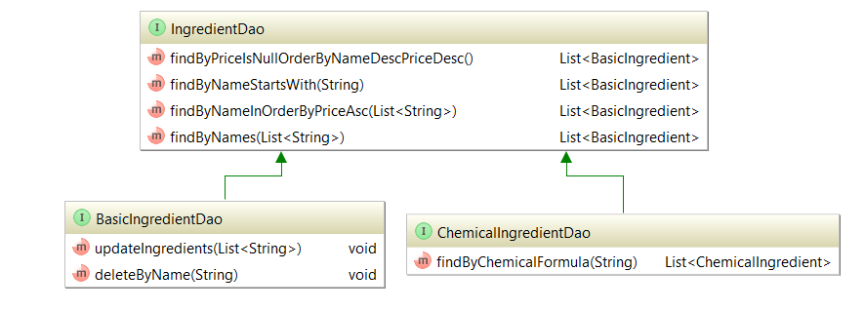
Repository Inheritance

Slide 20
Repository Inheritance
Not a repository
IngredientDao.java
@NoRepositoryBean
public interface IngredientDao<T extends Ingredient> extends JpaRepository<T, Long>{
//…
}
ChemicalIngredientDao.java
@Repository
public interface ChemicalIngredientDao extends IngredientDao<BasicChemicalIngredient> {
List<ChemicalIngredient> findByChemicalFormula(String chemicalFormula);
}

Slide 21
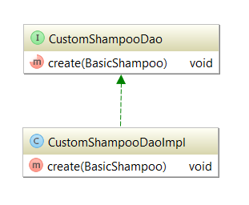
Custom Repository Implementation

Slide 22
Repository Inheritance
CustomShampooDao.java
public interface CustomShampooDao {
void create(BasicShampoo basicShampoo);
}
CustomShampooDaoImpl.java
public class CustomShampooDaoImpl implements CustomShampooDao {
@PersistenceContext
private EntityManager entityManager;
@Transactional
public void create(BasicShampoo basicShampoo){
entityManager.persist(basicShampoo);
}
}
Inject Entity Manager
Single Transaction

Slide 23
Spring Configuration

Slide 24
Application Properties
application.properties
#Data Source Properties
spring.datasource.driverClassName = com.mysql.jdbc.Driver
spring.datasource.url = jdbc:mysql://localhost:3306/neck_and_elbow?useSSL=false&createDatabaseIfNotExist=true
spring.datasource.username = root
spring.datasource.password = 1234
Connection properties

Slide 25
Java-Based Configuration
Configuration Class
JavaConfig.java
Repositories Directory
@Configuration
@EnableJpaRepositories(basePackages = "com.neckandelbows.dao")
@EnableTransactionManagement
@PropertySource(value = "application.properties" )
public class JavaConfig {
//Add configuration
}
Enable Transaction Management
Property File

Slide 26
Java-Based Configuration
JavaConfig.java
@Autowired
private Environment environment;
@Bean
public DataSource dataSource() {
DriverManagerDataSource driverManagerDataSource = new DriverManagerDataSource(); driverManagerDataSource.setDriverClassName(environment.getProperty("spring.datasource.driverClassName"));
driverManagerDataSource.setUrl(environment.getProperty("spring.datasource.url"));
driverManagerDataSource.setUsername(environment.getProperty("spring.datasource.username"));
driverManagerDataSource.setPassword(environment.getProperty("spring.datasource.password"));
return driverManagerDataSource;
}
Data Source Connection

Slide 27
Java-Based Configuration
JavaConfig.java
@Bean
public EntityManagerFactory entityManagerFactory() {
HibernateJpaVendorAdapter vendorAdapter = new HibernateJpaVendorAdapter();
vendorAdapter.setDatabase(Database.MYSQL);
vendorAdapter.setGenerateDdl(true);
vendorAdapter.setShowSql(true);
LocalContainerEntityManagerFactoryBean factory = new LocalContainerEntityManagerFactoryBean();
factory.setJpaVendorAdapter(vendorAdapter);
factory.setPackagesToScan("com.neckandelbows.domain");
factory.setDataSource(dataSource());
Properties jpaProperties = new Properties();
jpaProperties.setProperty("hibernate.hbm2ddl.auto","validate");
jpaProperties.setProperty("hibernate.format_sql", "true");
factory.setJpaProperties(jpaProperties);
factory.afterPropertiesSet();
return factory.getObject();
}
JPA Configuration
Models Package

Slide 28
Java-Based Configuration
JavaConfig.java
@Bean
public PlatformTransactionManager transactionManager() {
JpaTransactionManager txManager = new JpaTransactionManager();
txManager.setEntityManagerFactory(entityManagerFactory());
return txManager;
}
Transaction Manager Configuration

Slide 29
Java-Based Configuration
JavaConfig.java
@Configuration
@EnableJpaRepositories(basePackages = "com.neckandelbows.dao")
@EnableTransactionManagement
@PropertySource(value = "application.properties" )
public class JavaConfig {
//Add configuration
@Bean
public CustomShampooDaoImpl shampooDaoImpl(){
return new CustomShampooDaoImpl();
}
}
Bean Definition

Slide 30

Summary
Query Methods
JPQL
Advanced Repositories
Spring configuration

Slide 31







Spring Data Advanced Querying
https://softuni.bg/courses/databases-advanced-hibernate

Slide 32
License
This course (slides, examples, demos, videos, homework, etc.) is licensed under the "Creative Commons Attribution-NonCommercial-ShareAlike 4.0 International" license
Attribution: this work may contain portions from
"Databases" course by Telerik Academy under CC-BY-NC-SA license

Slide 33





Free Trainings @ Software University
Software University Foundation – softuni.org
Software University – High-Quality Education, Profession and Job for Software Developers
softuni.bg
Software University @ Facebook
facebook.com/SoftwareUniversity
Software University Forums
forum.softuni.bg

